Slide 1
Time, speed and distance
Topics to be covered:-
Speed, time and distance
Average speed
Km/h and m/s
Relative speed
Train
Boats

Slide 2
Speed
Speed = distance/time
So, distance = speed × time
And, time = distance/speed

Slide 3
Examples of problems on speed
Example 1- A man has to cover a distance of 200 km at speed of 40 kmph. One day, he started 1 hour late but still reached on time. By what % did he increase the speed of his journey?
Solution : Time with normal speed = 200/40 = 5 hr
New time = 5-1 = 4 hr
New speed = 200/4 = 50 kmph
The percentage increase = (50-40)/40 × 100 = 25%
Example 2- A is twice as fast as B. The journey covered by B in 40 minutes will be covered by A in how much time?
Solution :
Example 3- The speed of a man increases by 14.28% as compared to his normal speed. If he is covering the same distance, by what % does the time taken decrease?
Solution :

Slide 4
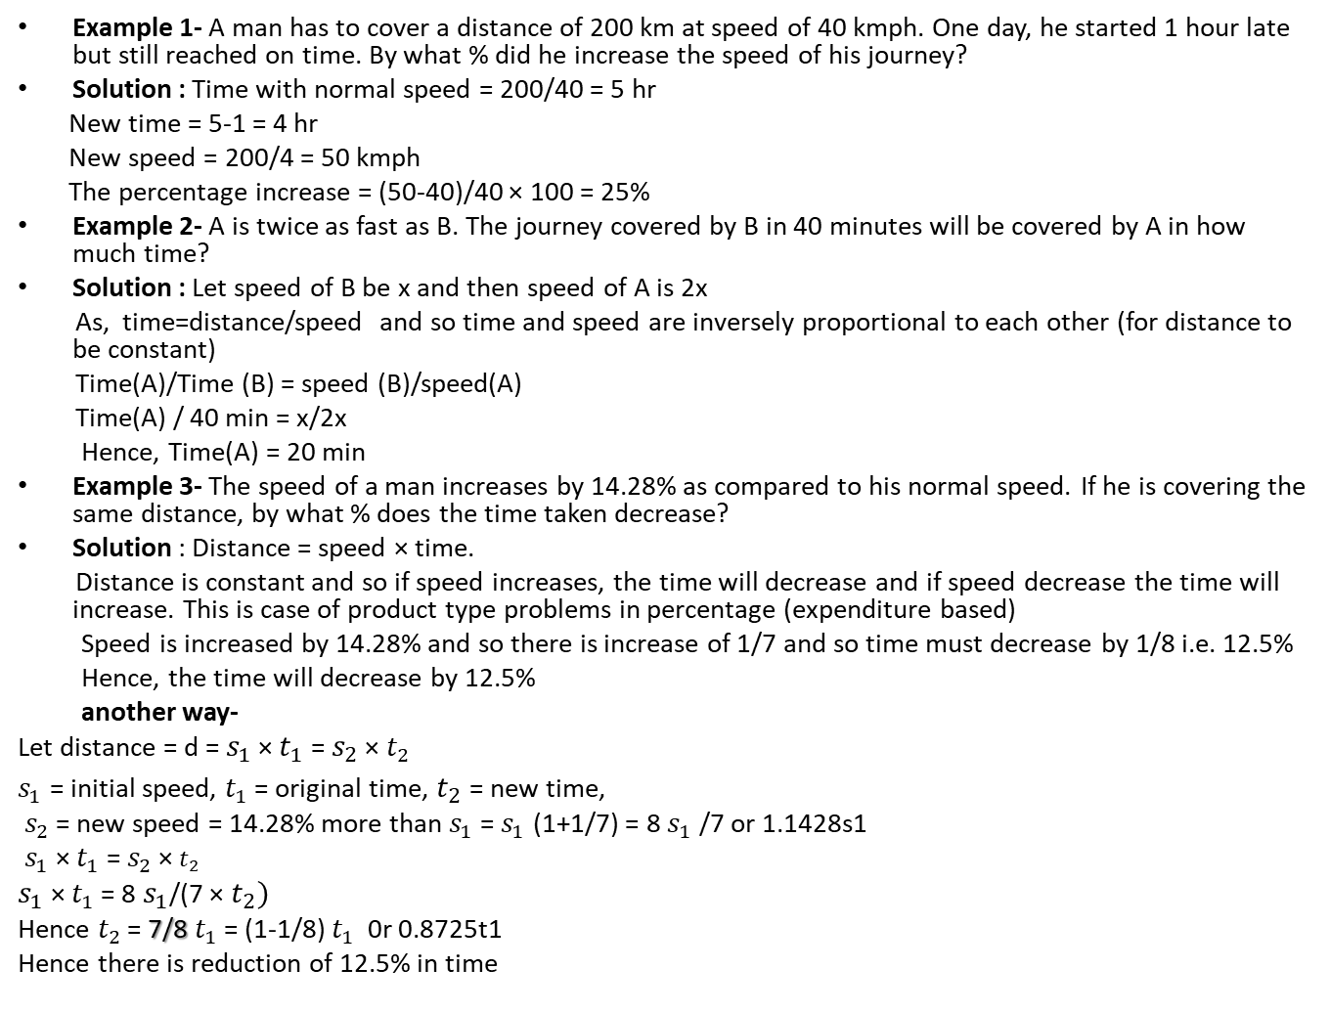
Examples of problems on speed
Example 1- A man has to cover a distance of 200 km at speed of 40 kmph. One day, he started 1 hour late but still reached on time. By what % did he increase the speed of his journey?
Solution : Time with normal speed = 200/40 = 5 hr
New time = 5-1 = 4 hr
New speed = 200/4 = 50 kmph
The percentage increase = (50-40)/40 × 100 = 25%
Example 2- A is twice as fast as B. The journey covered by B in 40 minutes will be covered by A in how much time?
Solution : Let speed of B be x and then speed of A is 2x
As, time=distance/speed and so time and speed are inversely proportional to each other (for distance to be constant)
Time(A)/Time (B) = speed (B)/speed(A)
Time(A) / 40 min = x/2x
Hence, Time(A) = 20 min
Example 3- The speed of a man increases by 14.28% as compared to his normal speed. If he is covering the same distance, by what % does the time taken decrease?
Solution : Distance = speed × time.
Distance is constant and so if speed increases, the time will decrease and if speed decrease the time will increase. This is case of product type problems in percentage (expenditure based)
Speed is increased by 14.28% and so there is increase of 1/7 and so time must decrease by 1/8 i.e. 12.5%
Hence, the time will decrease by 12.5%
another way-
Let distance = d = $s_{1}$ × $t_{1}$ = $s_{2}$ × $t_{2}$
$s_{1}$ = initial speed, $t_{1}$ = original time, $t_{2}$ = new time,
$s_{2}$ = new speed = 14.28% more than $s_{1}$ = $s_{1}$ (1+1/7) = 8 $s_{1}$ /7 or 1.1428s1
$s_{1}$ × $t_{1}$ = $s_{2}$ × $t_{2}$
$s_{1}$ × $t_{1}$ = 8 $s_{1}$/(7 × $t_{2})$
Hence $t_{2}$ = 7/8 $t_{1}$ = (1-1/8) $t_{1}$ 0r 0.8725t1
Hence there is reduction of 12.5% in time

Slide 5
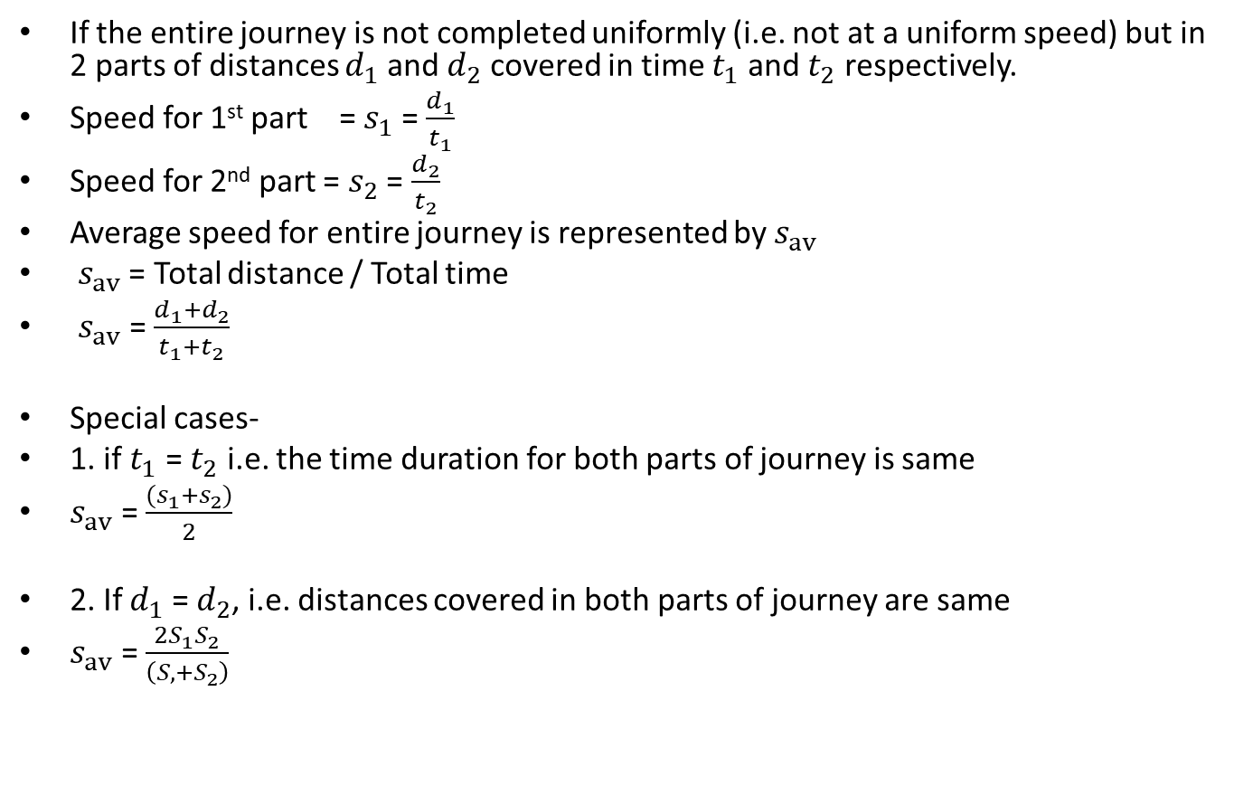
Average Speed
If the entire journey is not completed uniformly (i.e. not at a uniform speed) but in 2 parts of distances $d_{1}$ and $d_{2}$ covered in time $t_{1}$ and $t_{2}$ respectively.
Speed for 1st part = $s_{1}$ = $\frac{d_{1}}{t_{1}}$
Speed for 2nd part = $s_{2}$ = $\frac{d_{2}}{t_{2}}$
Average speed for entire journey is represented by $s_{av}$
$s_{av}$ = Total distance / Total time
$s_{av}$= $\frac{d_{1}+d_{2}}{t_{1}+t_{2}}$
Special cases-
1. if $t_{1}$ = $t_{2}$ i.e. the time duration for both parts of journey is same
$s_{av}$ = $\frac{{(s}_{1}+s_{2})}{2}$
2. If $d_{1}$ = $d_{2}$, i.e. distances covered in both parts of journey are same
$s_{av}$ = $\frac{2S_{1}S_{2}}{\left(S,+S_{2}\right)}$

Slide 6
Examples of average speed
Example 1- A man covered a distance of 200 km in such a way that he travelled for 50% of time with speed 40 km/h and remaining part with speed of 50km/h?
Solution-
Example 2- A man covered a distance in such a way that he travelled for 220 km in 4 hours of time and remaining 80 km in 1 hour. What is the average speed for entire journey?
Solution-
Example 3- A man covered a distance of 300 km in such a way that he travelled 220 km with speed of 110 km/h remaining distance was covered with speed of 40 km/h. What is the average speed for entire journey
Solution-
Example 4- Aman travelled from Gurgaon to Agra with speed 40 km/h and then went back to Gurgaon from Agra at speed 60 km/h. What is the average speed for entire journey?
Solution-

Slide 7
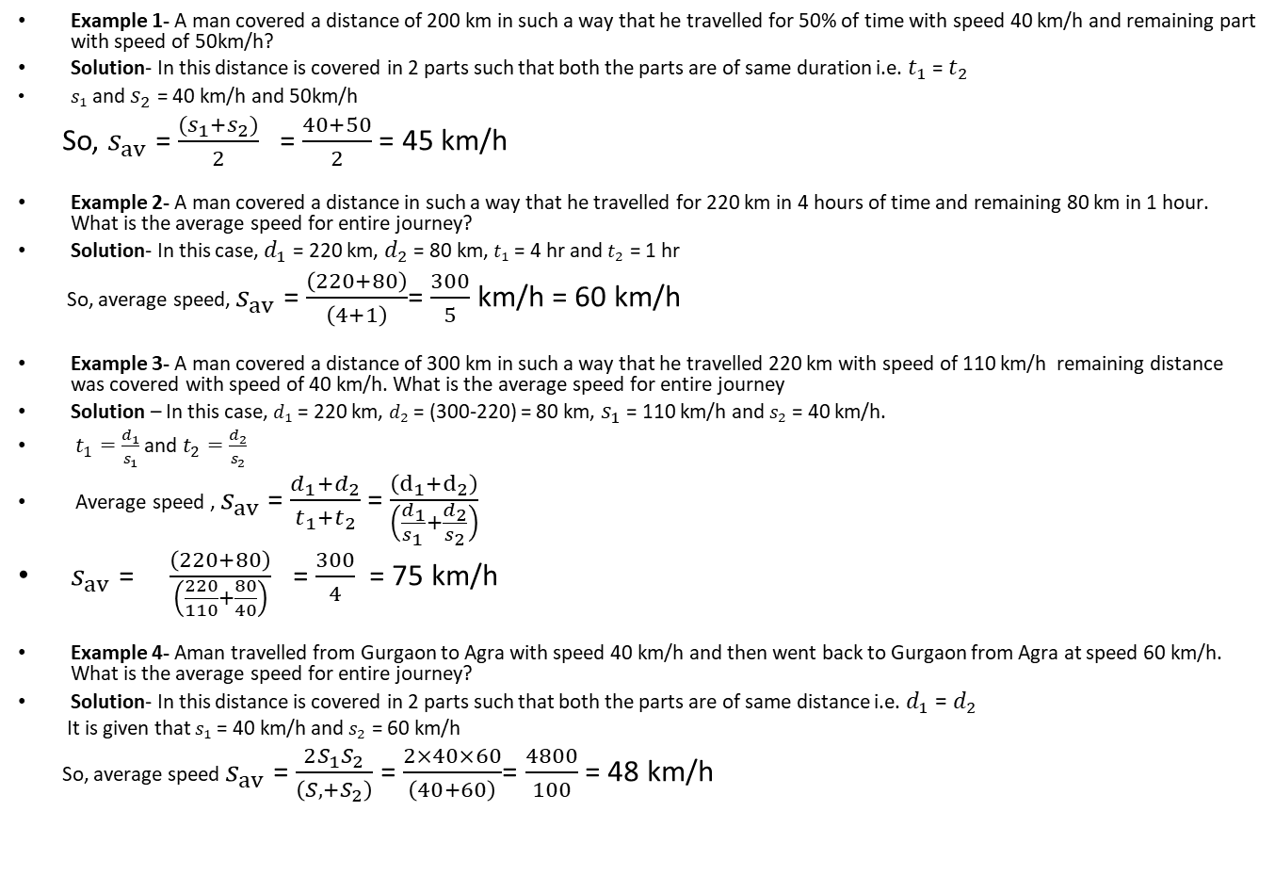
Examples of average speed
Example 1- A man covered a distance of 200 km in such a way that he travelled for 50% of time with speed 40 km/h and remaining part with speed of 50km/h?
Solution- In this distance is covered in 2 parts such that both the parts are of same duration i.e. $t_{1}$ = $t_{2}$
$s_{1}$ and $s_{2}$ = 40 km/h and 50km/h
So, $s_{av}$ = $\frac{{(s}_{1}+s_{2})}{2}$ = $\frac{40+50}{2}$= 45 km/h
Example 2- A man covered a distance in such a way that he travelled for 220 km in 4 hours of time and remaining 80 km in 1 hour. What is the average speed for entire journey?
Solution- In this case, $d_{1}$ = 220 km, $d_{2}$ = 80 km, $t_{1}$ = 4 hr and $t_{2}$ = 1 hr
So, average speed, $s_{av}$ = $\frac{\left(220+80\right)}{\left(4+1\right)}$= $\frac{300}{5}$ km/h = 60 km/h
Example 3- A man covered a distance of 300 km in such a way that he travelled 220 km with speed of 110 km/h remaining distance was covered with speed of 40 km/h. What is the average speed for entire journey
Solution – In this case, $d_{1}$ = 220 km, $d_{2}$ = (300-220) = 80 km, $s_{1}$= 110 km/h and $s_{2}$ = 40 km/h.
$t_{1}=\frac{d_{1}}{s_{1}}$ and $t_{2}=\frac{d_{2}}{s_{2}}$
Average speed , $s_{av}$= $\frac{d_{1}+d_{2}}{t_{1}+t_{2}}$= $\frac{\left(ⅆ_{1}+ⅆ_{2}\right)}{\left(\frac{d_{1}}{s_{1}}+\frac{d_{2}}{s_{2}}\right)}$
$s_{av}$ = $\frac{\left(220+80\right)}{\left(\frac{220}{110}+\frac{80}{40}\right)}$ = $\frac{300}{4}$ = 75 km/h
Example 4- Aman travelled from Gurgaon to Agra with speed 40 km/h and then went back to Gurgaon from Agra at speed 60 km/h. What is the average speed for entire journey?
Solution- In this distance is covered in 2 parts such that both the parts are of same distance i.e. $d_{1}$ = $d_{2}$
It is given that $s_{1}$ = 40 km/h and $s_{2}$ = 60 km/h
So, average speed $s_{av}$ = $\frac{2S_{1}S_{2}}{\left(S,+S_{2}\right)}$= $\frac{2×40×60}{\left(40+60\right)}$= $\frac{4800}{100}$ = 48 km/h

Slide 8
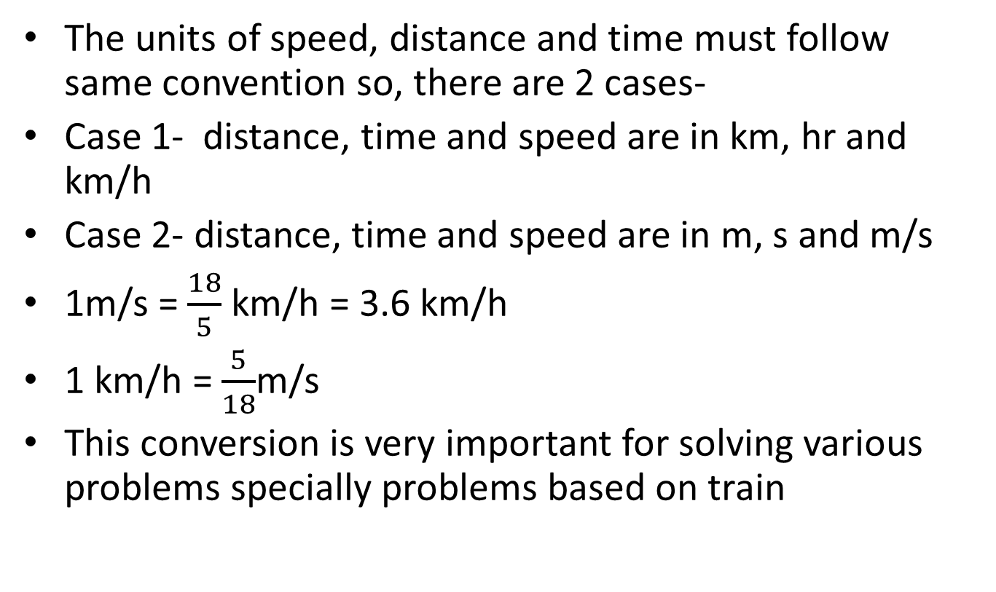
Km/h and m/s
The units of speed, distance and time must follow same convention so, there are 2 cases-
Case 1- distance, time and speed are in km, hr and km/h
Case 2- distance, time and speed are in m, s and m/s
1m/s = $\frac{18}{5}$ km/h = 3.6 km/h
1 km/h = $\frac{5}{18}$m/s
This conversion is very important for solving various problems specially problems based on train

Slide 9
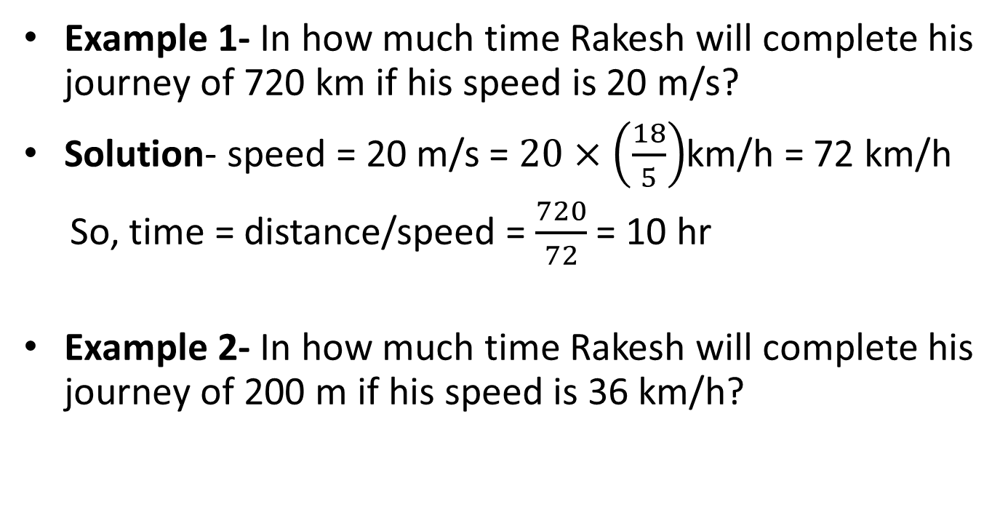
Examples of conversion of km/h and m/s
Example 1- In how much time Rakesh will complete his journey of 720 km if his speed is 20 m/s?
Solution- speed = 20 m/s = $20×\left(\frac{18}{5}\right)$km/h = 72 km/h
So, time = distance/speed = $\frac{720}{72}$ = 10 hr
Example 2- In how much time Rakesh will complete his journey of 200 m if his speed is 36 km/h?

Slide 10
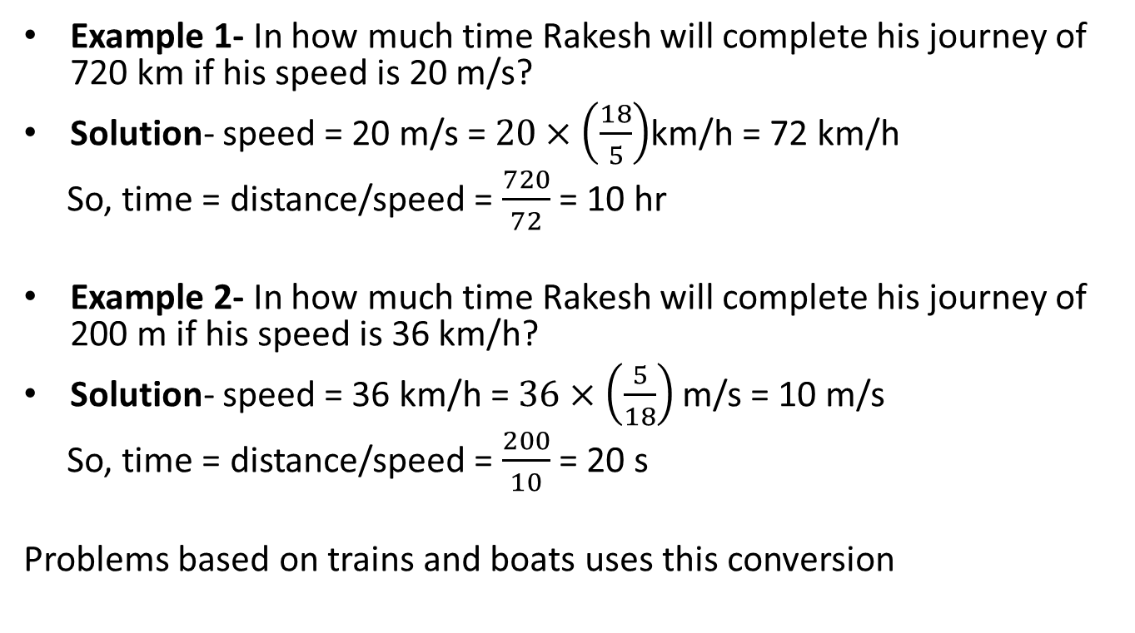
Examples of conversion of km/h and m/s
Example 1- In how much time Rakesh will complete his journey of 720 km if his speed is 20 m/s?
Solution- speed = 20 m/s = $20×\left(\frac{18}{5}\right)$km/h = 72 km/h
So, time = distance/speed = $\frac{720}{72}$ = 10 hr
Example 2- In how much time Rakesh will complete his journey of 200 m if his speed is 36 km/h?
Solution- speed = 36 km/h = $36×\left(\frac{5}{18}\right)$m/s = 10 m/s
So, time = distance/speed = $\frac{200}{10}$ = 20 s
Problems based on trains and boats uses this conversion

Slide 11
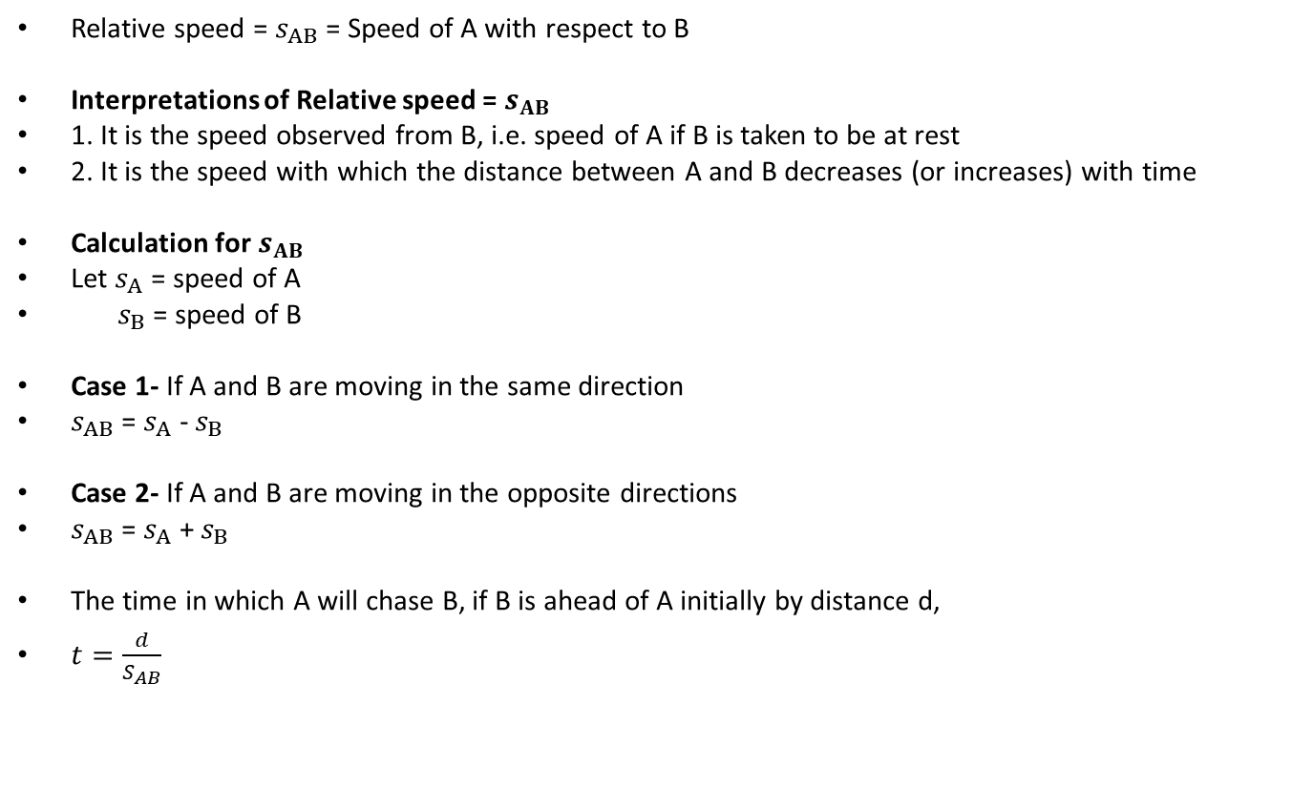
Relative speed
Relative speed = $s_{AB}$ = Speed of A with respect to B
Interpretations of Relative speed = $s_{AB}$
1. It is the speed observed from B, i.e. speed of A if B is taken to be at rest
2. It is the speed with which the distance between A and B decreases (or increases) with time
Calculation for $s_{AB}$
Let $s_{A}$ = speed of A
$s_{B}$ = speed of B
Case 1- If A and B are moving in the same direction
$s_{AB}$ = $s_{A}$ - $s_{B}$
Case 2- If A and B are moving in the opposite directions
$s_{AB}$ = $s_{A}$ + $s_{B}$
The time in which A will chase B, if B is ahead of A initially by distance d,
$t=\frac{d}{S_{AB}}$

Slide 12
Examples of problems on relative speed
Case 1- If object B is ahead of A and we need to find time in which A will chase B
Example 1- Ajay is chasing Vijay who is 100 m ahead of him and moving with the speed of 15 m/s. In how much time he will catch Vijay if he is moving with speed 25 m/s ?
Solution- This type of problems can be approached in 2 ways-
1st approach- lf initial distance is d then,
(Speed of A) × t = d + (speed of B) × t
2nd approach – We can solve by using formula
t= initial distance/relative speed = d/relative speed
Example 2- B starts from point M and is moving at 25 m/sec. After 4 seconds, A starts in the same direction at a speed of v m/sec. If A overtakes B 20 seconds after he started, find the ratio of the speeds of A to B?
Solution- This is a moderate type of question. We can solve this by using the above given 2 approaches with little adjustments

Slide 13
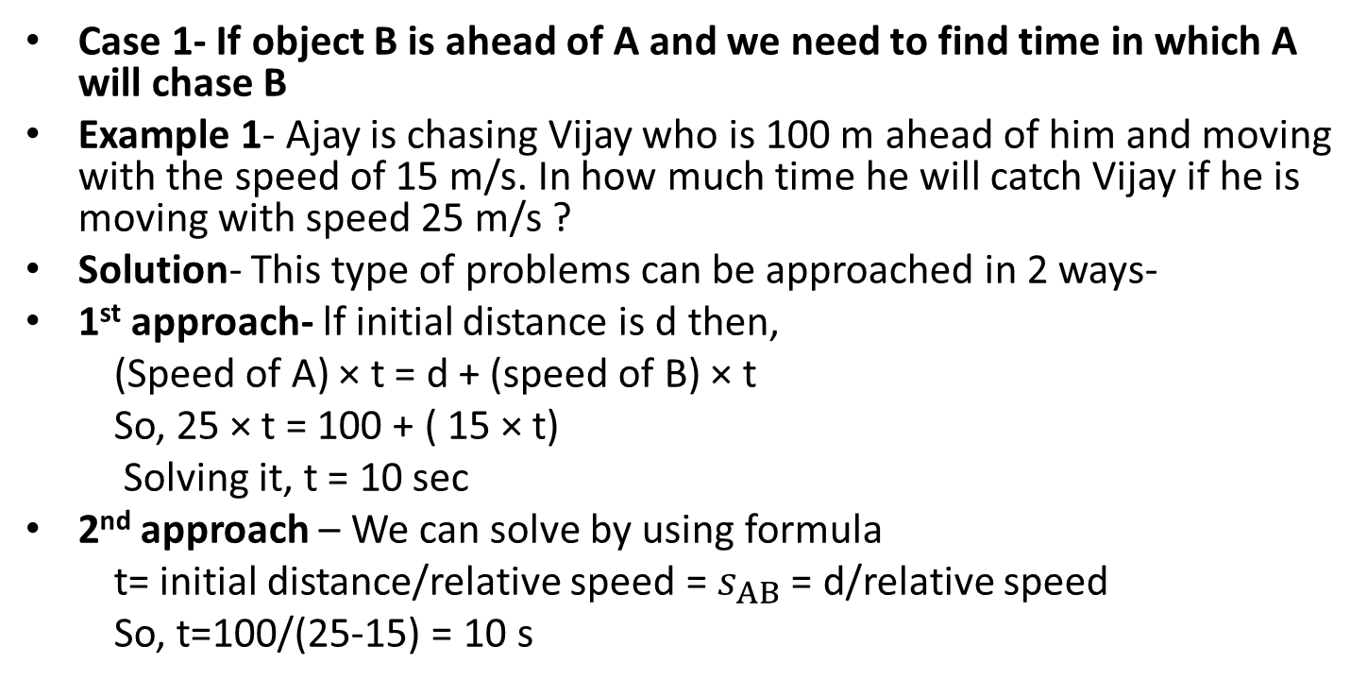
Examples of problems on relative speed
Case 1- If object B is ahead of A and we need to find time in which A will chase B
Example 1- Ajay is chasing Vijay who is 100 m ahead of him and moving with the speed of 15 m/s. In how much time he will catch Vijay if he is moving with speed 25 m/s ?
Solution- This type of problems can be approached in 2 ways-
1st approach- lf initial distance is d then,
(Speed of A) × t = d + (speed of B) × t
So, 25 × t = 100 + ( 15 × t)
Solving it, t = 10 sec
2nd approach – We can solve by using formula
t= initial distance/relative speed = $s_{AB}$ = d/relative speed
So, t=100/(25-15) = 10 s

Slide 14
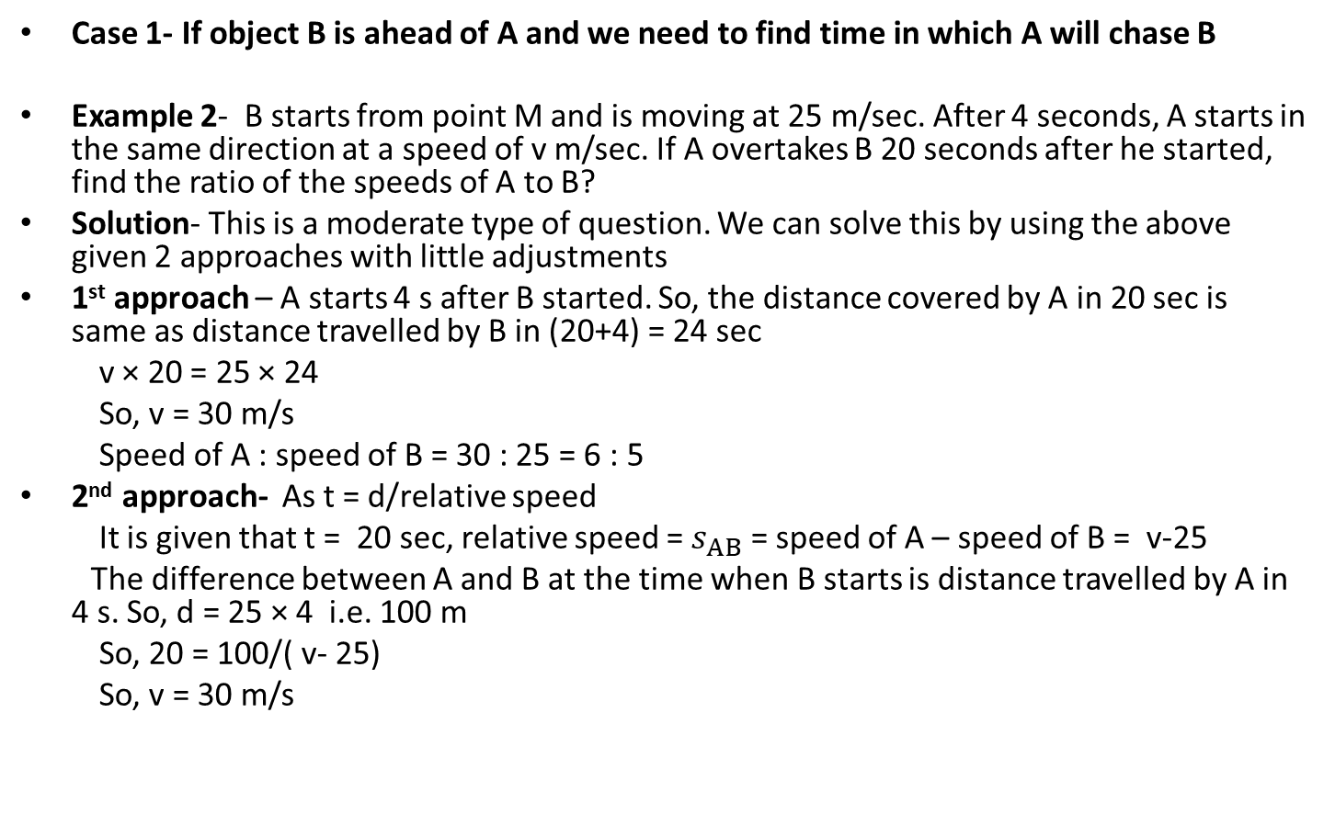
Examples of problems on relative speed
Case 1- If object B is ahead of A and we need to find time in which A will chase B
Example 2- B starts from point M and is moving at 25 m/sec. After 4 seconds, A starts in the same direction at a speed of v m/sec. If A overtakes B 20 seconds after he started, find the ratio of the speeds of A to B?
Solution- This is a moderate type of question. We can solve this by using the above given 2 approaches with little adjustments
1st approach – A starts 4 s after B started. So, the distance covered by A in 20 sec is same as distance travelled by B in (20+4) = 24 sec
v × 20 = 25 × 24
So, v = 30 m/s
Speed of A : speed of B = 30 : 25 = 6 : 5
2nd approach- As t = d/relative speed
It is given that t = 20 sec, relative speed = $s_{AB}$ = speed of A – speed of B = v-25
The difference between A and B at the time when B starts is distance travelled by A in 4 s. So, d = 25 × 4 i.e. 100 m
So, 20 = 100/( v- 25)
So, v = 30 m/s

Slide 15
Examples of problems on relative speed
Case 2- Objects A and B (at some distance) are moving in opposite direction and we need to find-
1. the time when they meet
or
2. the point at which they meet
Example 1- 2 Trains start from A and B and move towards B and A respectively. Train from A starts at 5 am and reaches B at 3 pm while the train from B starts at 8 am and reaches A at 2 pm. At what time will the 2 trains meet?
Solution-

Slide 16
Examples of problems on relative speed
Case 2- Objects A and B (at some distance) are moving in opposite direction and we need to find-
1. the time when they meet
or
2. the point at which they meet
Example 1- 2 Trains start from A and B and move towards B and A respectively. Train from A starts at 5 am and reaches B at 3 pm while the train from B starts at 8 am and reaches A at 2 pm. At what time will the 2 trains meet?
Solution- Train from A takes 10 hours for the journey while the train from B takes 6 hours for the journey.
The distance is not known and so we must assume some value for that. So, let the distance is LCM of time taken by both and so let the distance be = LCM (10,6) km = 30 km
The total distance is taken as LCM (which is 30 km here) such that their speeds will be 3 kmph and 5 kmph.
Let the first train travel for 3 hours such that the time for both the trains will then be equal and we can use the concept of relative speed.
Distance covered by the first train = 3 kmph x 3 = 9 km
Remaining distance = 30-9 = 21 km
Relative speed = 3+5 = 8kmph
Time required = 21/8 = 2 and 5/8 hours after 8 am.

Slide 17
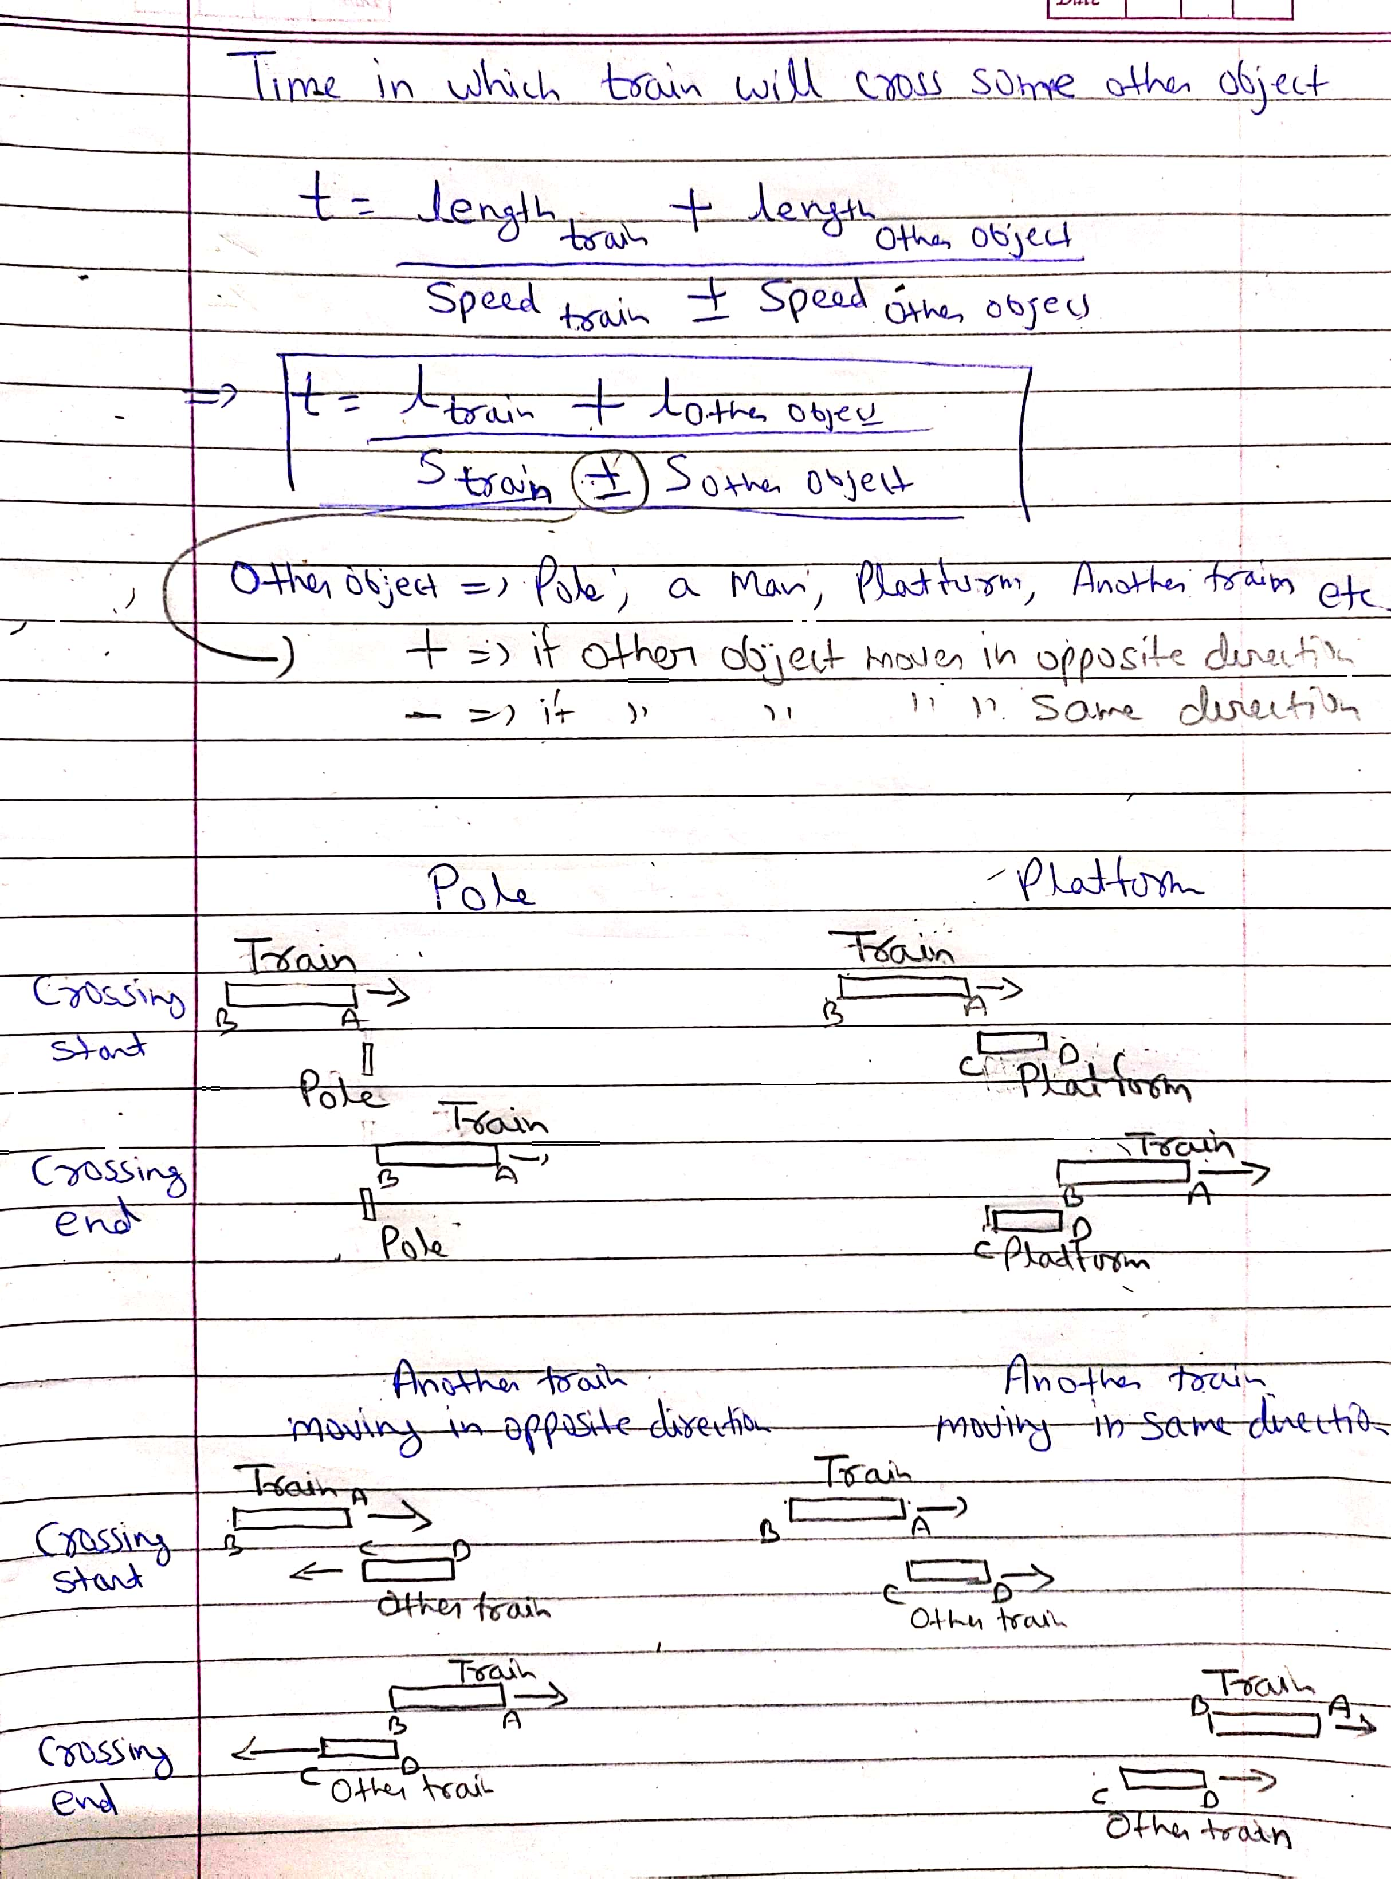
Time taken by train to cross some other object

Slide 18
More about problems on train
Approach- In most of these types of problems, either the speed or length of train is given. Further there we are given 2 scenarios. In the 1st scenario we can find the length or speed or train (which is not given) and then use both length and speed of train to find the required answer
In these problems the speed of train is given in km/h and it must be converted to m/s to solve the problem
Confusion regarding the object train is crossing
In these problems the object train is crossing a pole, a man who may be stationary or moving in same or opposite direction that of train, platform, another train which may be stationary or moving in same or opposite direction that of train.
So, there are so many possible cases, many a times it becomes quite confusing. So, we need to focus on what information is given to us about the other object. If there is no information about speed or length or both for other object, it should be taken to be zero
For example there will be no information about speed or length of pole, so length and speed of pole is zero in these problems. So, we can say that if length or speed or both are non-zero then their numerical value must be provided in the problem
Please check the solved examples in next slide for better understanding

Slide 19
Examples of problems on trains
Example 1- A Train travelling at 72 kmph overtakes a man standing on a platform in 10 seconds. How much time would be required if the man is moving in the same direction as the Train at 18 kmph?
Solution- In 1st scenario, train is crossing a man (who is stationary) in 10 sec. We know that speed of train is 72 km/h = 72 × (5/18) = 20 m/s. The length of train is not given, which can be obtained in 1st equation,
10 = (length of train + 0)/(20 ± 0)
Length of train = 200 m
In 2nd scenario, the same train is crossing the same man who is now moving in same direction as train with speed of 18 km/h = 18 (5/18) = 5 m/s. In this case we can use length of train = 200 m, which is obtained in 1st scenario
t = (200 + 0)/(20-5) = 200/15 = 40/3 = 13.33 sec

Slide 20
Example 2 - A Train 200 m long passes a coffee shop in 10 seconds and another train of the same length travelling in the opposite direction passes a tree in 8 seconds. Find the difference between the speed of the second train and first train?
Solution-
Example 3- A Train travelling @ 54 km/hr overtakes a man walking in the same direction @ 5 m/sec in 20 seconds. In how much time will the Train cross a Platform 160 m long?
Solution –

Slide 21
Example 2 - A Train 200 m long passes a coffee shop in 10 seconds and another train of the same length travelling in the opposite direction passes a tree in 8 seconds. Find the difference between the speed of the second train and first train?
Solution- The length and speed for coffee shop and tree are 0
Case 1- 1st train crosses a coffee shop
t = (length of 1st train + 0)/(speed of 1st train ±0)
10 = (200+0)/(speed of 1st train±0)
Speed of 1st train = 20 m/s
Case 2- 2nd train crosses a tree
Length of 2nd train = length of 1st train = 200
t = (length of 2nd train + 0)/(speed of 2nd train ± 0)
8 = (200+0)/(speed of 2nd train±0)
Speed of 2nd train = 25 m/s
Required difference = 25 m/s – 20 m/s = 5 m/s
Example 3- A Train travelling @ 54 km/hr overtakes a man walking in the same direction @ 5 m/sec in 20 seconds. In how much time will the Train cross a Platform 160 m long?
Solution – Speed of train = 54 km/h = 54 (5/18) m/s = 15 m/s
Case 1- The train crosses a man (walking in same direction with speed 5 m/s) in 20 sec
t = (length of train +0)/(speed of train – speed of man)
20 = (length of train +0)/(15-5)
20 = (length of train)/10
Length of train = 200 m
Case 2- the train crosses a platform of length 160 m
t = (length of train+160)/(speed of train±0)
t = (200+160)/ 15 = 360/15
t = 24 sec

Slide 22
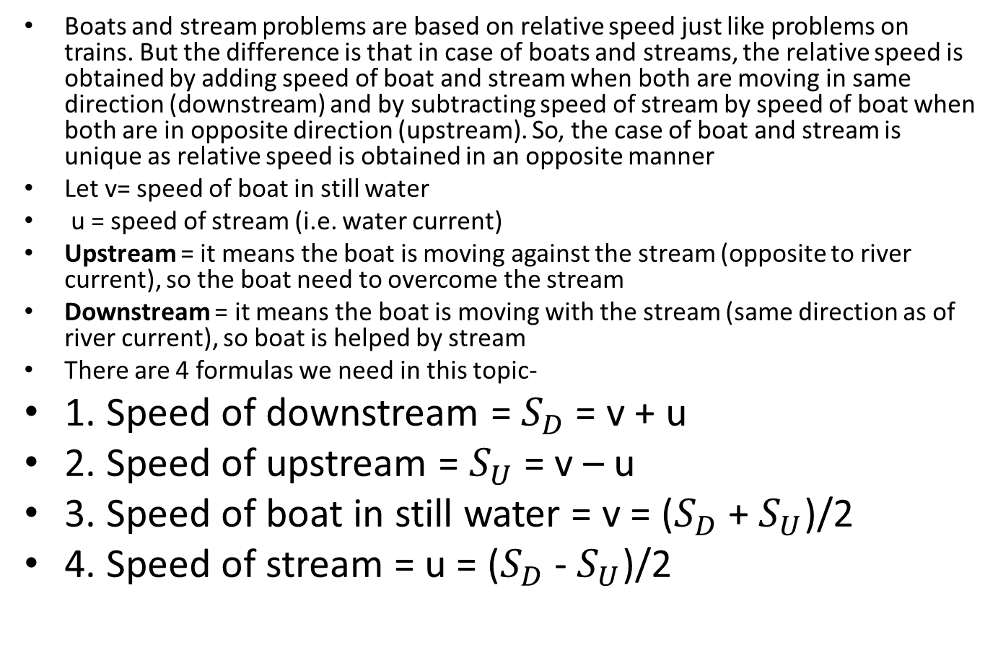
Boats and streams
Boats and stream problems are based on relative speed just like problems on trains. But the difference is that in case of boats and streams, the relative speed is obtained by adding speed of boat and stream when both are moving in same direction (downstream) and by subtracting speed of stream by speed of boat when both are in opposite direction (upstream). So, the case of boat and stream is unique as relative speed is obtained in an opposite manner
Let v= speed of boat in still water
u = speed of stream (i.e. water current)
Upstream = it means the boat is moving against the stream (opposite to river current), so the boat need to overcome the stream
Downstream = it means the boat is moving with the stream (same direction as of river current), so boat is helped by stream
There are 4 formulas we need in this topic-
1. Speed of downstream = $S_{D}$ = v + u
2. Speed of upstream = $S_{U}$ = v – u
3. Speed of boat in still water = v = ($S_{D}$ + $S_{U}$)/2
4. Speed of stream = u = ($S_{D}$ - $S_{U}$)/2

Slide 23
Examples of problems on boats and streams
Example 1- If the upstream speed of a man in a boat is 40% of the downstream speed and the man covers 18 km upstream in 3 hours, how much distance will the man cover in 5 hours while travelling in still water?
Example 2- A man can row at 10 kmph in still water. If the speed of the stream is 2 kmph and it takes 2 hour to row to a place and come back, how far is the place?

Slide 24
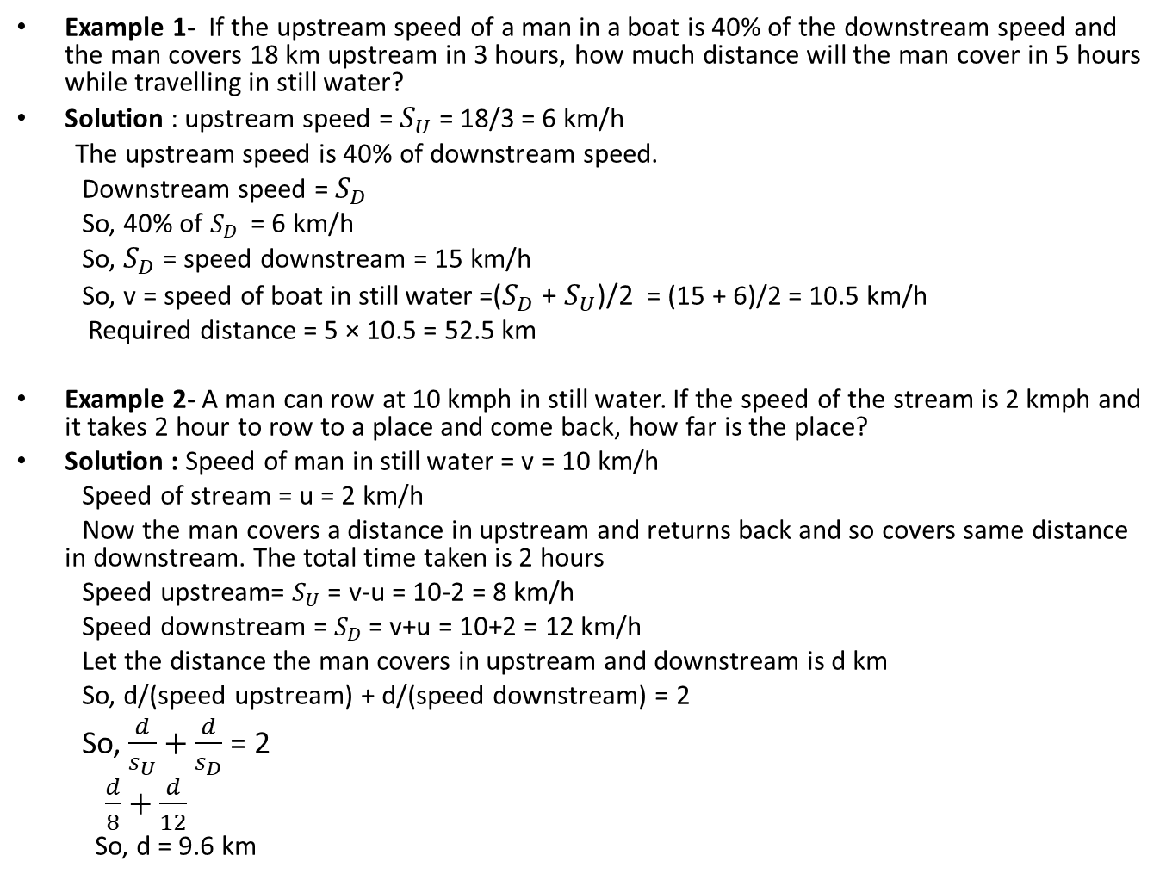
Examples of problems on boats and streams
Example 1- If the upstream speed of a man in a boat is 40% of the downstream speed and the man covers 18 km upstream in 3 hours, how much distance will the man cover in 5 hours while travelling in still water?
Solution : upstream speed = $S_{U}$ = 18/3 = 6 km/h
The upstream speed is 40% of downstream speed.
Downstream speed = $S_{D}$
So, 40% of $S_{D}$ = 6 km/h
So, $S_{D}$= speed downstream = 15 km/h
So, v = speed of boat in still water =($S_{D}$ + $S_{U}$)/2 = (15 + 6)/2 = 10.5 km/h
Required distance = 5 × 10.5 = 52.5 km
Example 2- A man can row at 10 kmph in still water. If the speed of the stream is 2 kmph and it takes 2 hour to row to a place and come back, how far is the place?
Solution : Speed of man in still water = v = 10 km/h
Speed of stream = u = 2 km/h
Now the man covers a distance in upstream and returns back and so covers same distance in downstream. The total time taken is 2 hours
Speed upstream= $S_{U}$ = v-u = 10-2 = 8 km/h
Speed downstream = $S_{D}$= v+u = 10+2 = 12 km/h
Let the distance the man covers in upstream and downstream is d km
So, d/(speed upstream) + d/(speed downstream) = 2
So, $\frac{d}{s_{U}}+\frac{d}{s_{D}}$ = 2
$\frac{d}{8}+\frac{d}{12}$
So, d = 9.6 km

